Slide 1
Non- Linear op-amp Applications
If op amp is operated with positive feedback or no feedback it operates in non linear mode
Op amp is operated with non linear devices and output reaches either positive or negative saturation.
Applications
Comparator
Regenerative comparator
Zero crossing detector
Window detector
Sample and hold circuit

Slide 2
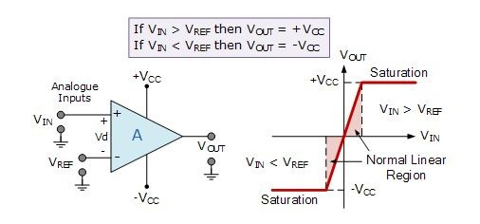
Comparators
The Op-amp
comparator compares one level with another analogue
analogue voltage
voltage level, or some preset reference voltage, V_{REF} and produces an output signal based on this voltage comparison.
The op-amp voltage comparator compares the magnitudes of two voltage inputs and determines which is the largest of the two.
Comparators either use positive feedback or no feedback at all (open-loop mode) to switch its output between two saturated states,

Slide 3
Assume that V_{IN} is less than the DC voltage level at V_{REF}, ( V_{IN} < V_{REF} ).
As the non-inverting (positive) input of the comparator is less than the inverting (negative) input, the output will be LOW and at the negative supply voltage, -Vcc resulting in a negative saturation of the output.
If we now increase the input voltage, V_{IN} so that its value is greater than the reference voltage V_{REF} on the inverting input, the output voltage rapidly switches HIGH towards the positive supply voltage, +Vcc resulting in a positive saturation of the output.
Types
Positive Voltage Comparator
Negative Voltage Comparator

Slide 4
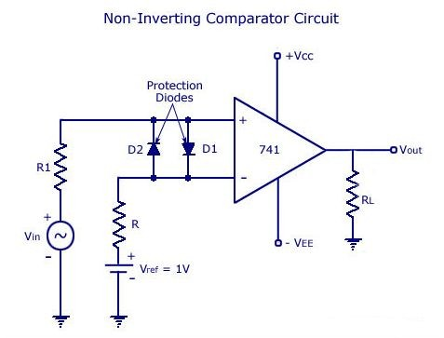
Positive Voltage Comparator
Positive voltage comparator, also known as a non-inverting comparator circuit detects when the input signal, V_{IN} is ABOVE or more positive than the reference voltage, V_{REF} producing an output at V_{OUT} which is HIGH

Slide 5
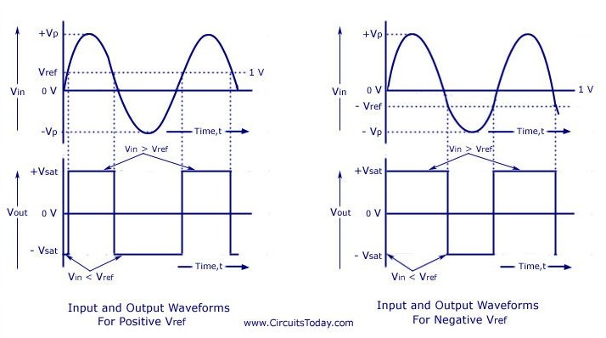

Slide 6
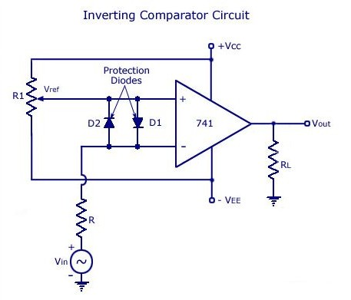
Negative Voltage Comparator
The basic conﬁguration for the negative voltage comparator, also known as an inverting comparator circuit detects when the input signal, VIN is BELOW or more negative than the reference voltage, VREF producing an output at VOUT which is HIGH

Slide 7
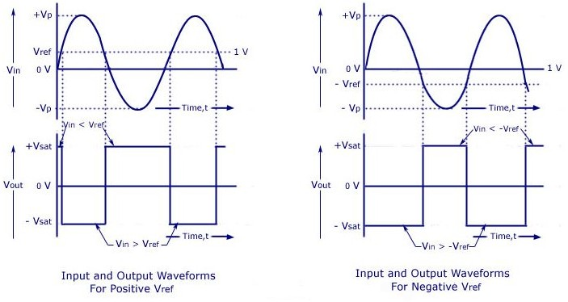

Slide 8
SCHMITT TRIGGER
(Regenerative Comparator)
Schmitt trigger is an inverting comparator with positive feedback.
It converts an irregular-shaped waveform to a square wave or pulse, also called as squaring circuit.
The input voltage Vin triggers the output V0 every time it exceeds certain voltage levels called the upper threshold voltage Vut and lower threshold voltage Vlt
These threshold voltages are obtained by using the voltage divider where the voltage across R1 is fed back to the input.
The voltage across R1 is a variable reference threshold voltage that depends on the value and polarity of the output voltage V0

Slide 9
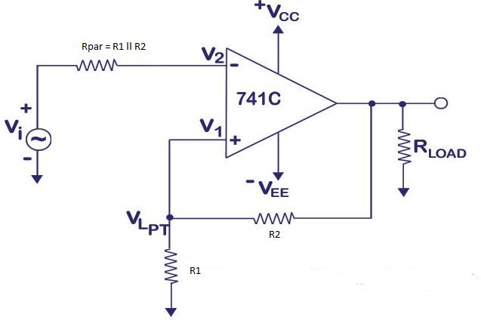

Slide 10

When Vo = +VSat, the voltage across R1 is called the upper threshold voltage, Vut The input voltage Vin must be slightly more positive than Vut in order to cause the output switch from +VSat to
-VSat. As long as Vin < Vut, V0 is at +VSat
Vut =R1/R1+R2 (+VSat)
When V0 = -Vsat, the voltage across R1 is referred to as lower threshold voltage, vin be slightly more negative than vlt in order to switch V0 from +Vsat to -Vsat. In other words, for vin values greater than vlt, vo is at -Vsat.
Vlt =R1/R1+R2 (-VSat)

Slide 11
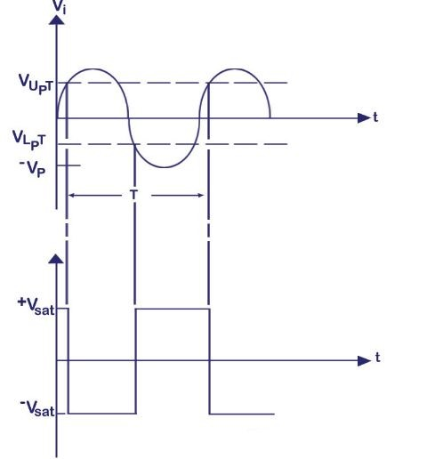
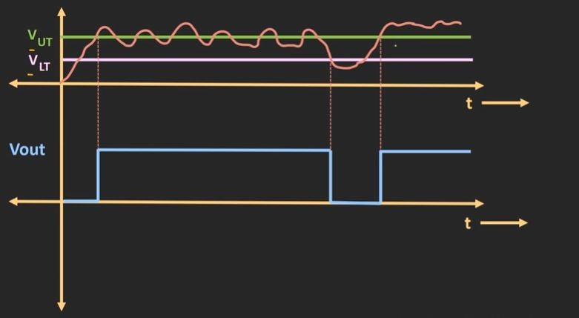
Waveforms

Slide 12
Filter
Filter is a frequency selective circuit that passes signal of specified Band of frequencies and attenuates the signals of frequencies outside the band
Type of Filter
Passive filters
Active filters

Slide 13
Passive filters
Passive
filters works well for high frequencies.
But at audio frequencies, the
problematic, as they become
inductors become
large, heavy and
expensive.For low frequency applications, more number of turns of wire must be used which in turn adds to the series resistance degrading inductor’s performance ie, low Q, resulting in high power dissipation .

Slide 14
Active filters
Active filters used element and resistors
op- amp as and capacitors
the active as passive
elements. By enclosing a capacitor in the feed back loop
, inductor less active filters can be obtained

Slide 15
some commonly used active filters
Low pass filter
High pass filter
Band pass filter
Band reject filter

Slide 16
Active Filters
Active filters use op-amp(s) and RC components.
Advantages over passive filters:
  op-amp(s) provide gain and overcome circuit losses
  increase input impedance to minimize circuit loading
  higher output power
  sharp cutoff characteristics can be produced simply and efficiently without bulky inductors
Single-chip universal filters (e.g. switched-capacitor ones) are available that can be configured for any type of filter or response.

Slide 17
Review of Filter Types & Responses
4 major types of filters: low-pass, high-pass, band pass, and band-reject or band-stop
0 dB attenuation in the pass band (usually)
3 dB attenuation at the critical or cutoff frequency, f_{c} (for Butterworth filter)
Roll-off at 20 dB/dec (or 6 dB/oct) per pole outside the passband (# of poles = # of reactive elements). Attenuation at any frequency, f, is:
⎛ f ⎞
atten.(dB) at f = log⎜ ⎟xatten.(dB) at f_{dec}
⎝ ^{f}c ⎠

Slide 18
Review of Filters
Bandwidth of a filter: BW = f_{cu} - f_{cl}
Phase shift: 45º/pole at f_{c}; 90º/pole at >> f_{c}
4 types of filter responses are commonly used:
  Butterworth - maximally flat in passband; highly non- linear phase response with frequency
  Bessel - gentle roll-off; linear phase shift with freq.
  Chebyshev - steep initial roll-off with ripples in passband
  Cauer (or elliptic) - steepest roll-off of the four types but has ripples in the passband and in the stop band

Slide 19
Frequency Response of Filters
A(dB)
A(dB)
A(dB)
HPF
BPF
LPF
Pass- band
f
f
f
f_{c}
f_{c}
^{f}cl ^{f}cu
A(dB)
A(dB)
Butterworth
BRF
Chebyshev
Bessel
f
f
^{f}cl
^{f}cu

Slide 20
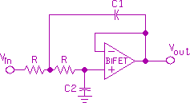
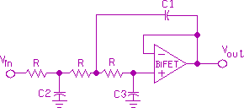
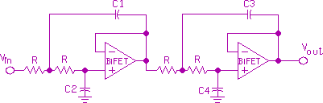
Unity-Gain Low-Pass Filter Circuits
2-pole
3-pole
4-pole

Slide 21
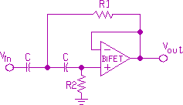
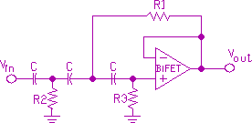
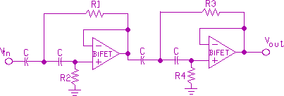
Unity-Gain High-Pass Filter Circuits
2-pole
3-pole
4-pole

Slide 22



Bandpass and Band-Rejection Filter
BPF
BRF
f
f
^{f}cu
^{f}cl ^{f}ctr ^{f}cl
^{f}ctr
^{f}cu
The quality factor, Q, of a filter is given by:
where BW = f_{cu} - f_{cl} and
^{f}ctr
BW
Q =
=
^{f}ctr ^{f}cu ^{f}cl

Slide 23
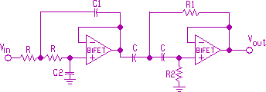
BANDPASS FILTER

Slide 24
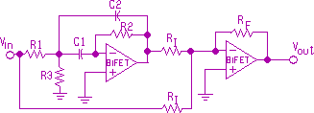
Band-Reject filter

